Slide 1
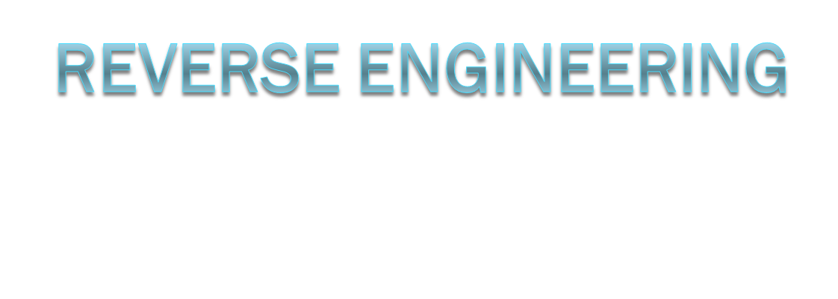
Tony Malatanos

Slide 2
Focal Points
What is reverse engineering?
Reasons
  Legit
  Malicious
Legality
Morality
Clean Room Design
Example: ReactOS

Slide 3
What is Reverse Engineering?
Instinctual need to know how things work
Analyzing and disassembling a closed system in order to reconstruct or modify it
Closed System
  No knowledge of inner workings or access to source code

Slide 4
Why RE? Legitimate Reasons
Loss of original source code
Derive design diagrams from source
  Flow charts
  Sequence diagrams
  Use case diagrams

Slide 5
Why RE? Malicious Reasons
Piracy
  Cracking commercial software
  Cracking copyright protection
  Bypassing security measures

Slide 6
Reverse Engineering: Legality
Copyright protection limitations
  Digital Millennium Copyright Act (DMCA)
    Provisions
      No circumventing digital protections
      No distribution of devices designed to circumvent digital protections
      No selling of anti-security tools
      No removing copyright information
      Safe harbor for Internet Service providers

Slide 7
Reverse Engineering: Legality
DMCA vs. DeCSS
  Universal v Reimerdes
    MPAA won case against 2600 magazine who was distributing DeCSS software
    DeCSS may not be distributed in any form
      Graphically
      Musically
      Illegal primes

Slide 8
Reverse Engineering: Morality
Piracy may be detrimental to a business or industry
Businesses go under
Individuals lose their jobs

Slide 9
Clean Room Design
Reverse engineering without infringing on copyrights
No prior knowledge of the certain techniques used to create original system

Slide 10
Clean Room Design: ReactOS
Free, open-source operating system that is Windows compatible
Goal
  To bring the large library of software and device drivers available on the Windows platform to a freely distributable operating system

